Slide 1

Department of computer science Detection of diabetic retinopathy using ALEXNET and LENET CNN models
Mentor:
Jananee V
Team members:
Nikghamanth S S- 180701153
Neya Babu.T-180701152

Slide 2
Abstract:
This study aims to develop a system to distinguish Diabetic retinopathy disease from fundus images.
In this work, we extracted different Diabetic retinopathy features such as Diabetic retinopathy, optic disc and lesions, applied convolutional neural network based models for the detection of multiple Diabetic retinopathy diseases with fundus photographs involved in structured analysis of the retinal (STARE - Structured Analysis of the Retina) database.
A variety of neuron-wise and layer-wise visualization methods were applied using CNN and trained with a publicly available Diabetic retinopathy disease image dataset. It is observed that neural networks can capture the colors and textures of lesions specific to respective diseases upon diagnosis, which resembles human decision-making.
This also an easy process which is easily done by CNN models.

Slide 3
Key challenges:
Filtering the image datasets of Diabetic Retinopathy from the STARE database takes alot of time.
Differentiating DR disease from fundus image.
High Processing System is required.

Slide 4
Motivation:
Diabetic Retinopathy is a deadly disease with no cure or prevention. Early detection and medications are the only way to stall it from complicating or becoming deadly. When a person is affected by DR, they slowly lose their eye sight leading to permanent blindness. This has lead us to take up this project and search for already existing methods used for early detection. We found certain flaws in those methods and thus decided to improve them with our proposed system for the betterment in treating people affected with this illness.

Slide 5
OBJECTIVE:
We proposed an approach with stage pretreatments that were performed to remove Diabetic retinopathy images from the given data sets and standardize them to a reasonable size and classified by Convolutional Neural Network which is a deep learning algorithm and success is achieved through deep learning technique. It proposed a system for predicting Diabetic retinopathy disease.
It explains about the experimental analysis of samples of images collected that are comprised of different stages Diabetic retinopathy disease. The primary attributes of the image are relied upon the shape and texture oriented features. An efficient disease detection and deep learning with convolutional neural networks (CNNs) achieved great success in the classification of various Diabetic retinopathy diseases.
A variety of neuron-wise and layer-wise visualization methods were applied using CNN, trained with a publicly available Diabetic retinopathy disease image dataset. The sample screenshots displays the Diabetic retinopathy disease detection using color based classification model and this model is deployed to a web application for Django (python) framework.

Slide 6
LITERATURE SURVEY:
Paper(year) | Technique used | Advantages | Disadvantages
A Deep Learning Ensemble Approach for Diabetic Retinopathy Detection | CNN model | Very high accuracy | Can’t be used to predict any other disease except TB. Data used to relatively shorter.
Improved and robust deep learning agent for preliminary detection of Diabetic Retinopathy using public datasets. | CNN model | Fast coverage of data sets having image with similar feature size | Processing time is large because of the huge dataset that is used here.
Detection of Diabetic Retinopathy Using Bichannel Convolutional Neural Network. | CNN model | Improves the detection performance by deep learning | Given dataset is relatively smaller.
Diabetic Retinopathy Classification Using ResNet50 and VGG-16 Pretrained Networks. | CNN model | High accuracy | Can’t be used to predict any other disease except TB. Data used to relatively shorter
Using Big Transfer to predict malaria (2021) | BigTransfer | Well classified and high accuracy | Not using Alexnet and Lenet for image classification

Slide 7
Literature survey:
Paper(year) | Technique used | Advantages | Disadvantages
Reliable Tuberculosis Detection using Chest X-ray with Deep Learning, Segmentation and Visualization (2020) | CNN model | Very high f1 scores were obtained | Dataset is relatively smaller.
Comparative Study on Generative Adversarial Networks (2018) | GAN types | - | -
Must-Read Papers on GANs (2019) | GAN types | - | -
Capsule Network GAN vs. DCGAN vs. Vanilla GAN for Apparel Image Generation (2021) | CNGAN, DCGAN, Apparel Image GAN | Crystal clear comparison of the three GAN models employed here | Very high processing time
Big Transfer (BiT): General Visual Representation Learning (2019) | Big Transfer | - | -

Slide 8
Proposed system:
An approach with which stage pretreatments that were performed to remove Diabetic retinopathy images from the given data sets and standardize them to a reasonable size are classified by Convolutional Neural Network, a deep learning algorithm and success is achieved. This proposes a system.
This system then explains about the experimental analysis of samples of images collected that are comprised of different stages Diabetic retinopathy disease. The primary attributes of the image are relied upon the shape and texture oriented features. An efficient disease detection and deep learning with convolutional neural networks (CNNs) achieved great success in the classification of various Diabetic retinopathy diseases.
A variety of neuron-wise and layer-wise visualization methods were applied using CNN, trained with a publicly available Diabetic retinopathy disease image dataset.

Slide 9
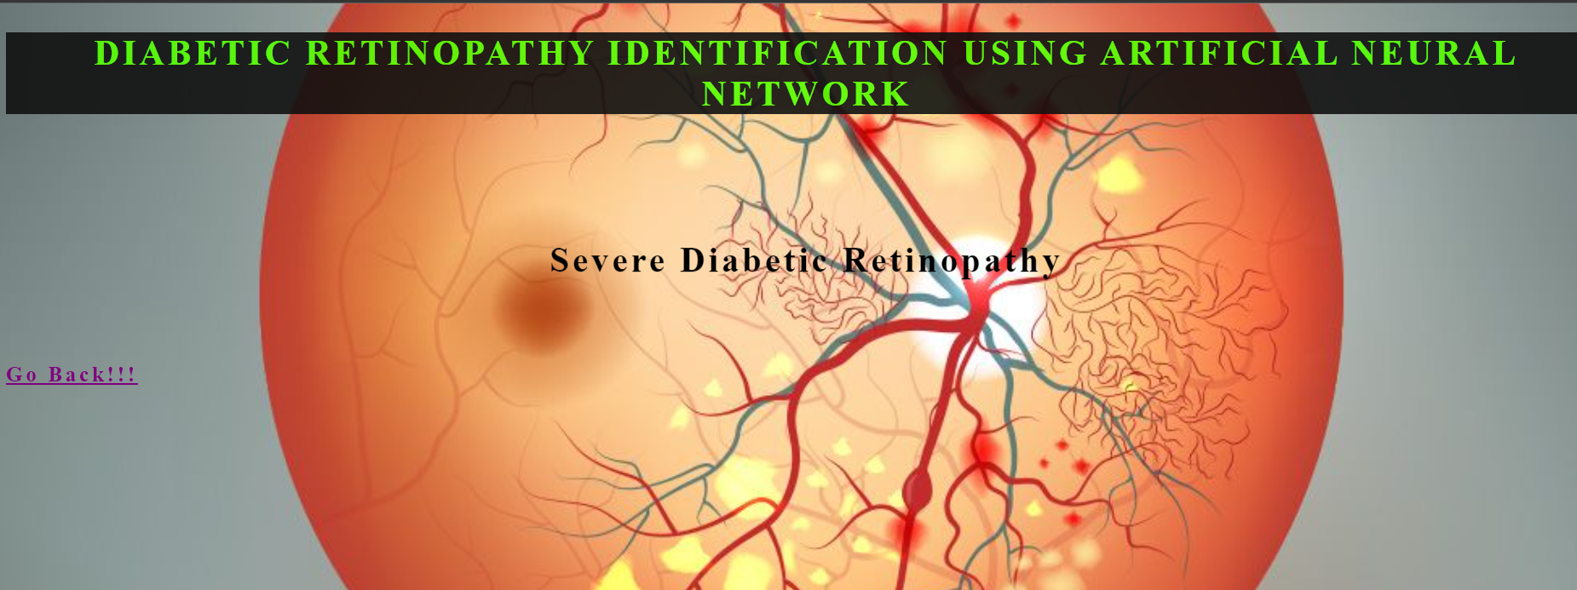
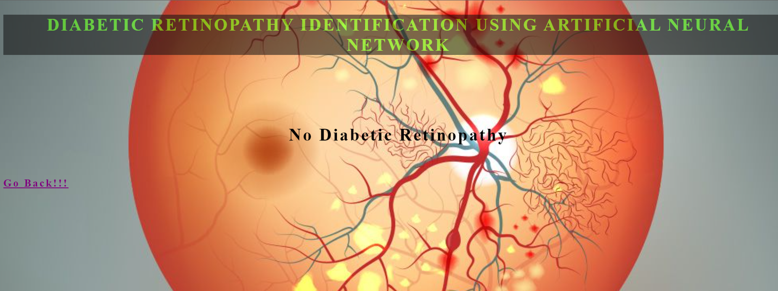
The sample screenshots displays the Diabetic retinopathy disease detection using color based classification model and this model is deployed to a web application for Django (python) framework.

Slide 10
Advantages of our proposed system:
Increasing throughput & reducing subjectiveness arising from human experts in detecting the Diabetic retinopathy decease.
The output shows whether the disease is detected or not (yes or no). This helps people to understand the results of their tests easily.

Slide 11
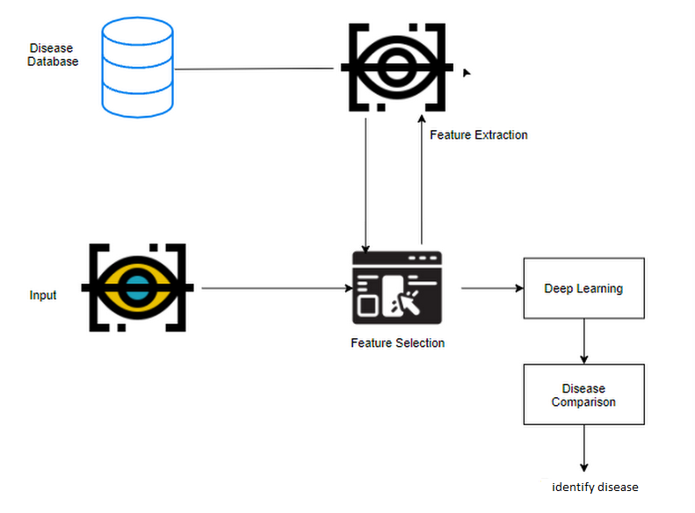
Architecture diagram:

Slide 12
System Requirements:
Software:
•Operating system : Windows 10
•Languages used : Python
•Software Package : Anaconda 3
Hardware:
Hard disk : 1 TB (minimum)
• Platform : IA-32(Windows Package Only)
• Ram : 8 GB RAM
• Processor : Pentium IV/III
• Processor speed : Minimum 1.99 GHZ

Slide 13
List of Modules:
Module 1 - ManualNet architecture ( An architecture we created with AlexNet and LeNet CNN models as base for processing the given images taken from the retinal database). [accuracy of 98.44%]
Module 2 - AlexNet architecture. [accuracy of 89.70%]
Module 3 - LeNet architecture. [accuracy of 98.44%]

Slide 14
Implementation:
The above mentioned 3 modules are implemented in jupyter notebook and the output is displayed after processing the given input images with epoch.
The output displays the accuracy, loss, val_accuracy and val_loss for each of the processed images taken at random from the testing dataset.
The output displayed in Django platform shows whether the patient is diagnosed with diabetic retinopathy or not. [if present it shows ‘Severe Diabetic Retinopathy’ and if not present it shows ‘No Diabetic Retinopathy’].

Slide 15
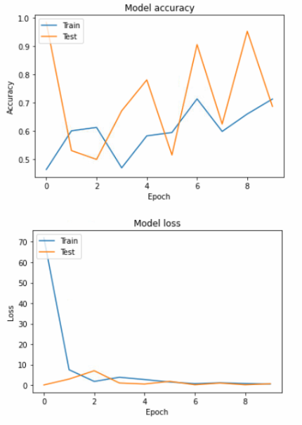
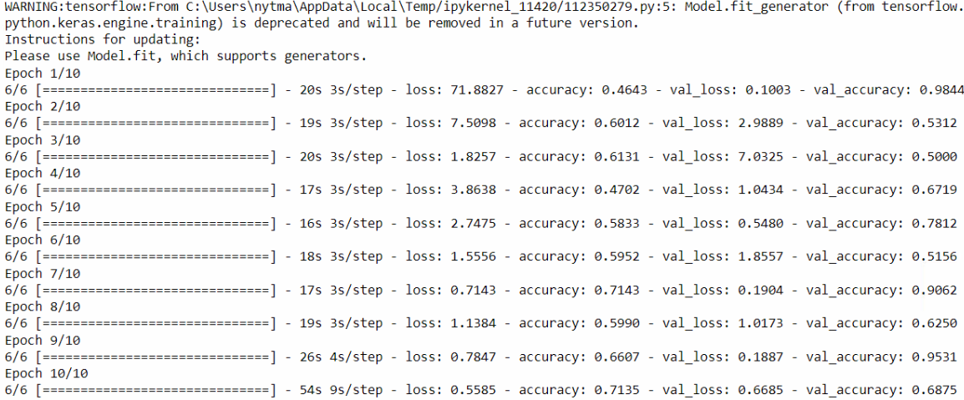
ManualNet Image processing :
Graphical Output :

Slide 16
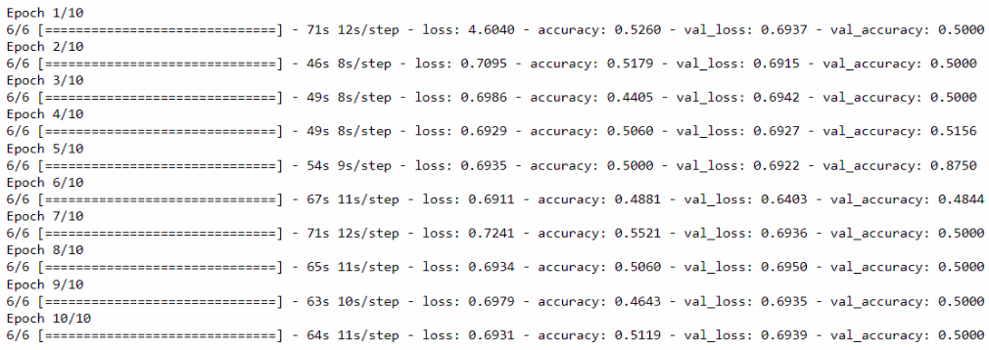
AlexNet Image processing :
Graphical Output :

Slide 17
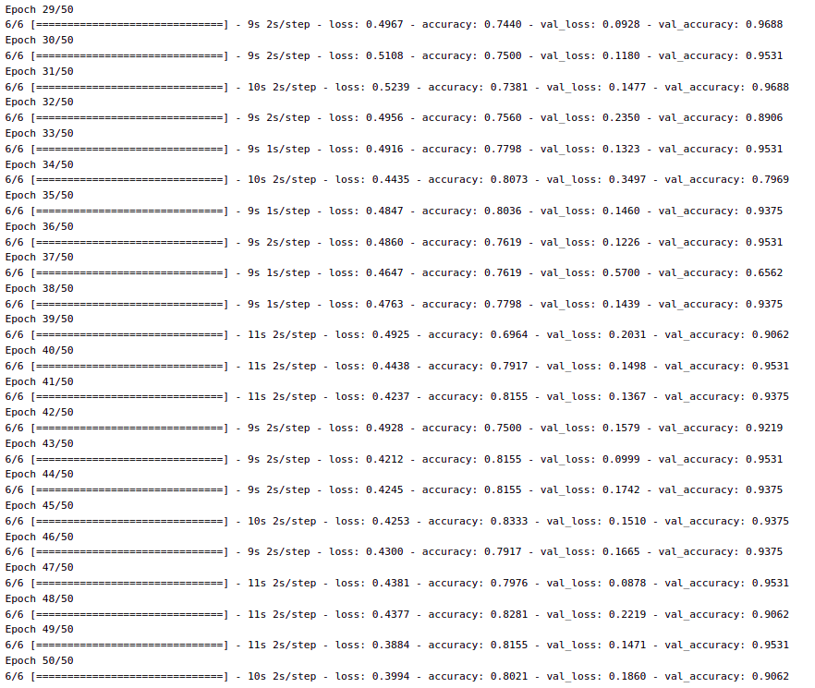
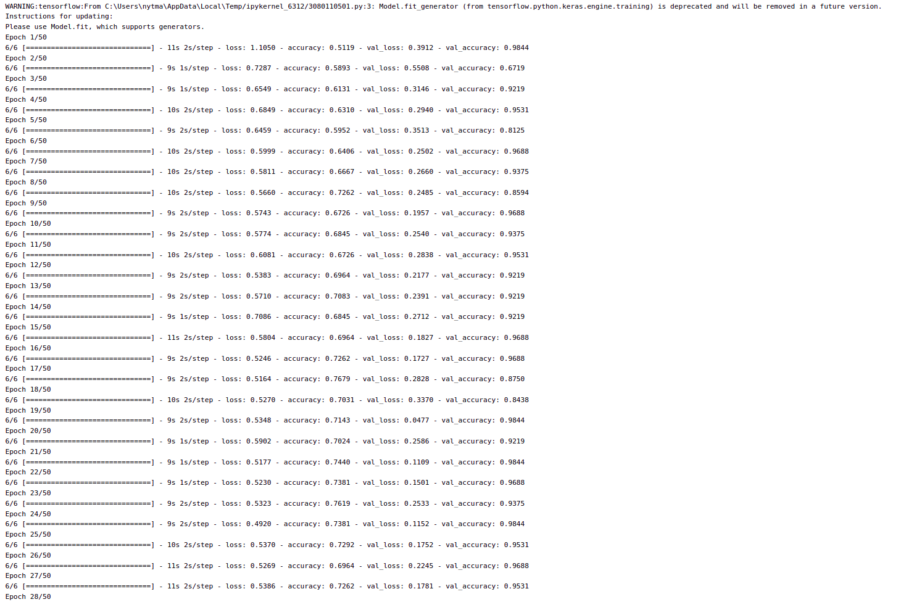
LeNet Image processing :

Slide 18
Advantages over existing system and applications:
This proposed system increases the throughput & reduces the subjectiveness arising from human experts in detecting the Diabetic retinopathy decease.
The output shows whether the disease is detected or not (‘yes or no’ type output). This helps people to understand the results of their tests easily.

Slide 19
Limitations & Future enhancements
Filtering the image datasets of Diabetic Retinopathy from the STARE database takes alot of time.
High Processing System is required.

Slide 20
Conclusion:
Diabetic Retinopathy is a deadly disease which can lead to permanant blindness if not detected in early stages.
By using our proposed system, the given input images can be easily classified as DR affected or not within seconds.
This can not only initiate treatment and medications, but can prevent the total vision loss for a longer period of time.

Slide 21
Future enhancement:
The developed ManualNet architecture can be further improved to yield more better results (accuracy-wise).
Comparing the architectures with recall, sensitivity and specificity along with existing comparison of accuracy and loss might help yielding better result.

Slide 22
References:
Thippa Reddy Gadekallu, Neelu Khare, Sweta Bhattacharya, Saurabh Singh, Praveen Kumar Reddy Maddikunta & Gautam Srivastava.
“Deep neural networks to predict diabetic retinopathy”.
Vijay Viswanathan.
Diabetic kidney disease and diabetic retinopathy: the ominous duo.
Kalpana Dash, Aftab Ahmed, Sambit Das, Balaji Jaganmohan, Surekha Tippisetty, Vamsi Krishna Kolukula & Krishna G. Seshadri.
“Diabetic retinopathy and its association with low glomerular filtration rate:
a cross-sectional analysis of diabetes patients of community clinics across India”.
Shivang Ganjoo,
“Diabetic Retinopathy Detection with ResNet50”.
Mobeen-ur-Rehman, Sharzil Haris Khan, Zeeshan Abbas & S.M. Danish Rizvi.
“Classification of Diabetic Retinopathy Images Based on Customised CNN Architecture

Slide 23
References:
Mohit Tripathi.
“Image Processing using CNN: A beginners guide”.
Shu-I Pao, Hong-Zin Lin, Ke-Hung Chien, Ming-Cheng Tai, Jiann-Torng Chen
& Gen-Min Lin.
“Detection of Diabetic Retinopathy Using Bichannel Convolutional Neural Network”.
Maziyar M. Khansari, William D. O’Neill, Richard D. Penn, Norman P. Blair
& Mahnaz Shahidi
“Detection of Subclinical Diabetic Retinopathy by Fine Structure Analysis of Retinal
Images”.
Louis Zizhao Wang, Carol Y Cheung, Robyn J Tapp, Haslina Hamzah, Gavin Tan,
Daniel Ting, Ecosse Lamoureux & Tien Yin Wong.
“Availability and variability in guidelines on diabetic retinopathy screening in Asian
countries”.

Slide 24
References:
GauravSaxena, Dhirendra KumarVerma, Amit Paraye, AlpanaRajan & AnilRawat.
“Improved and robust deep learning agent for preliminary detection of Diabetic
Retinopathy using public datasets”.
Seema Garg & Richard M. Davis.
“Diabetic Retinopathy Screening Update”.
Mike Voets, Kajsa Møllersen & Lars Ailo Bongo.
“Development and validation of a deep learning algorithm for detection of Diabetic
Retinopathy in retinal fundus photographs”.
Soumya Joshi, Dhirendra Kumar Verma, Gaurav Saxena & Amit Paraye.
“Issues in Training a Convolutional Neural Network Model for Image Classification”.
"Diabetic Retinopathy Detection." Kaggle.

Slide 25
THANK YOU

